Slide 2
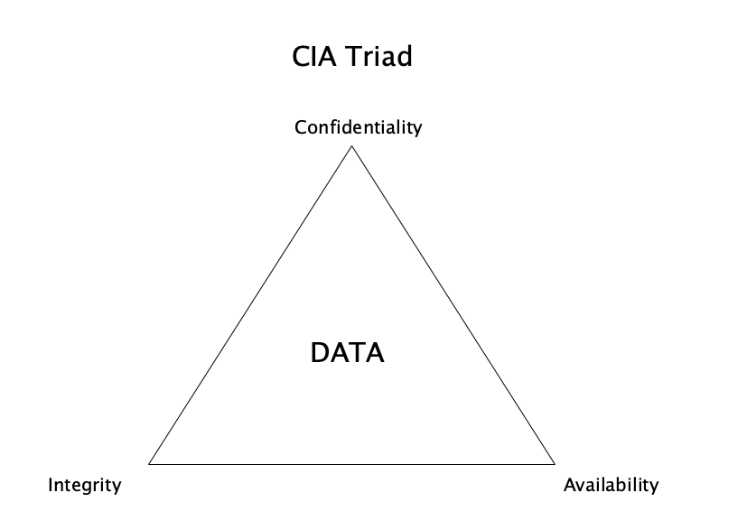
Principles of Security

Slide 3
Vulnerability
Weakness
Examples
Software bugs
Defaults
Weak passwords
Notes:
Is a weakness which can be exploited by a threat actor, such as an attacker, to cross perform unauthorized actions within a computer system.

Slide 4
Threat
Events that violate CIA
Examples
Malware
Phishing scam
Hackers
Notes:
Any entity, circumstance, capability, action, or event that could cause harm

Slide 5
Attacks
Exploits Vulnerabilities
Network Attacks
Application Attacks
Notes:
Is any attempt to expose, alter, disable, destroy, steal or gain unauthorized access to or make unauthorized use of an asset.

Slide 6
Social Engineering
Bad people tricking authorized users

Slide 7
Social Engineering – Techniques
Phishing
Vishing
Smishing
Spear phishing
Whaling
Spam
Spim (instant messaging)
Notes:
Authority, Trust, Urgency, Familiarity, Scarcity

Slide 8
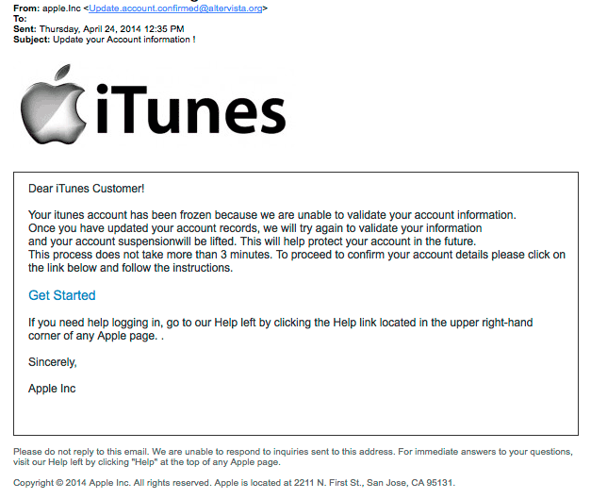
Phishing
Notes:
Authority, Trust, Urgency, Familiarity, Scarcity

Slide 9

Vishing
Notes:
Authority, Trust, Urgency, Familiarity, Scarcity

Slide 10
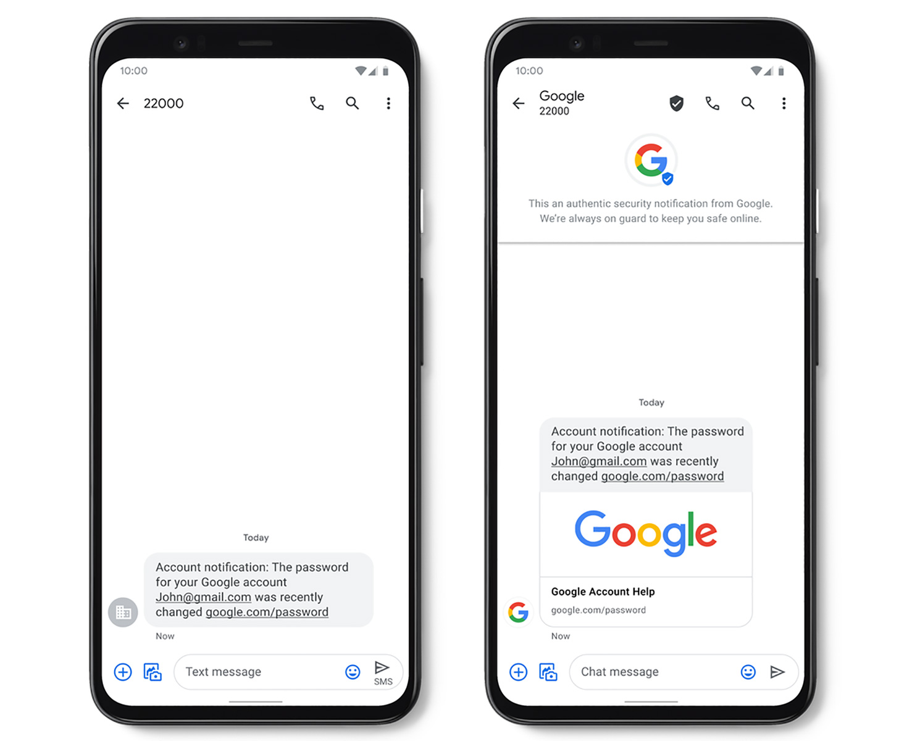
Smishing

Slide 11

Spear Phishing

Slide 12

Whaling

Slide 13


Social Engineering – Techniques
Spam
Spim (instant messaging)
Notes:
Authority, Trust, Urgency, Familiarity, Scarcity

Slide 14
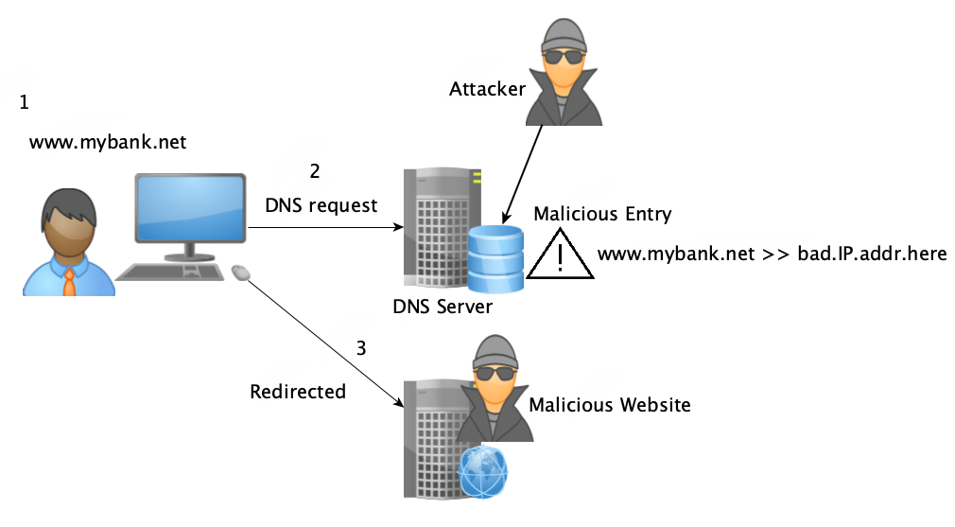
Pharming
Notes:
DNS Cache Poisoning - Redirect to bogus website, steal user’s sensitive info

Slide 15
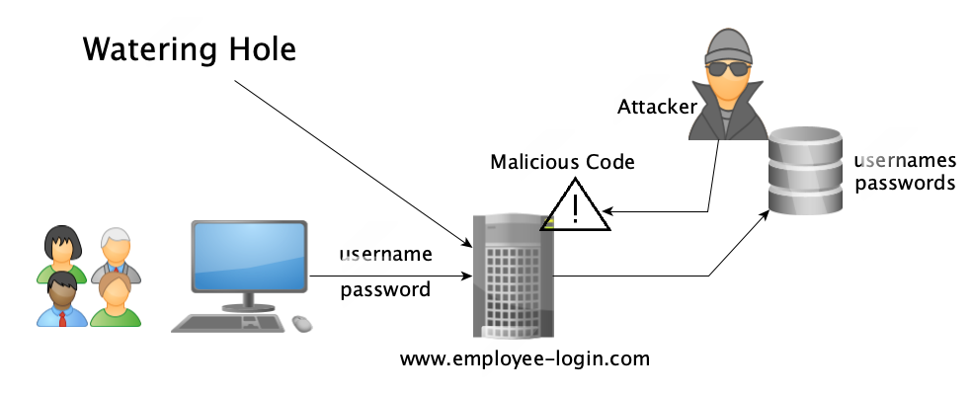
Watering Hole attack
Notes:
Credential Harvesting (familiarity)
Watering Hole Attack ( consensus, familiarity)
https://www.lastline.com/blog/five-high-profile-watering-hole-attacks-highlight-importance-of-network-security/

Slide 16
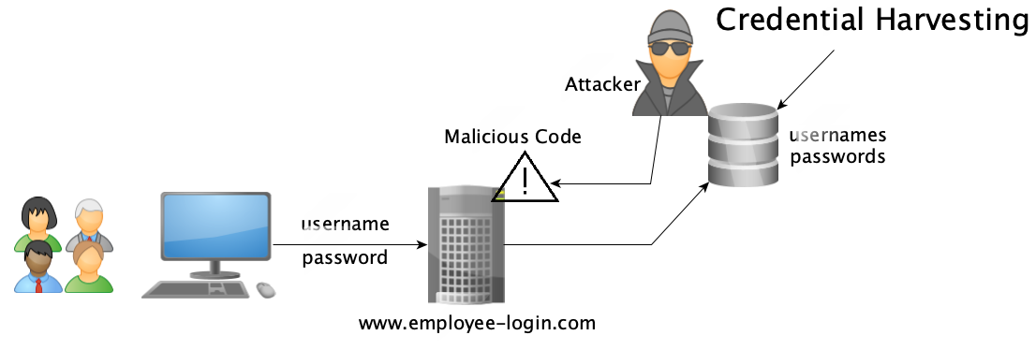
Credential harvesting
Notes:
Credential Harvesting (familiarity)
Watering Hole Attack ( consensus, familiarity)

Slide 17
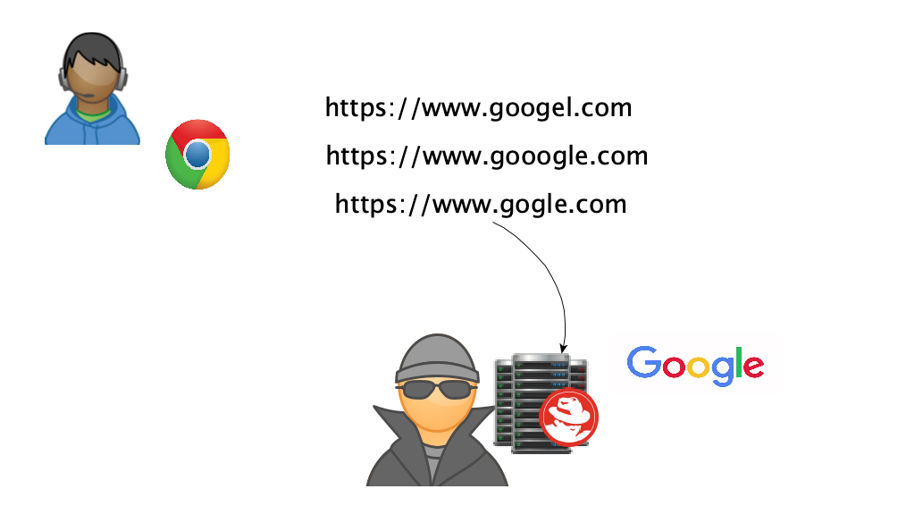
Typo Squatting
Notes:
Clicking these links and going to the website might also initiate a drive-by download attack

Slide 18
Social Engineering
Physical Techniques
Dumpster diving
Shoulder surfing
Tailgating
Pretexting

Slide 19
Social Engineering
Outliers
Invoice scam
Hoax
Prepending

Slide 20
Summary
Identify the techniques
Explain the techniques
Compare and contrast the techniques

